Slide 1
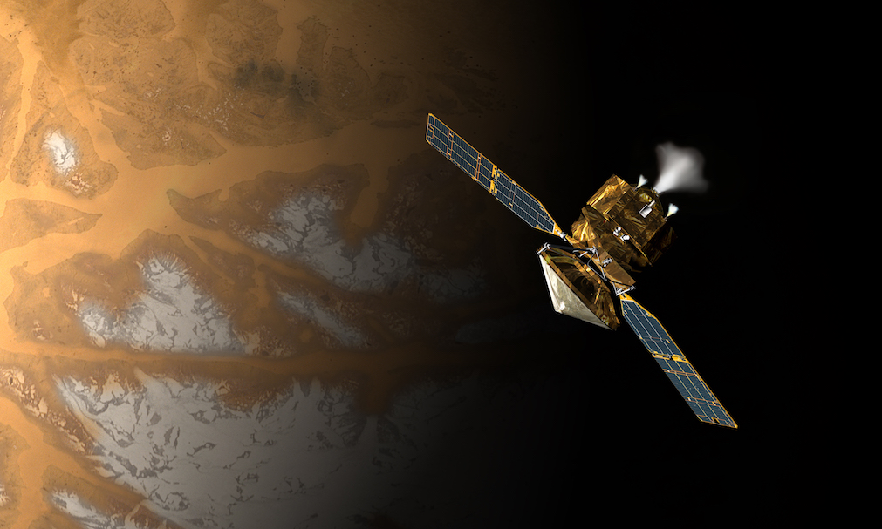
Analysis of NASA HiRISE Mars Landmarks
Thomas Lu
MSML651

Slide 2
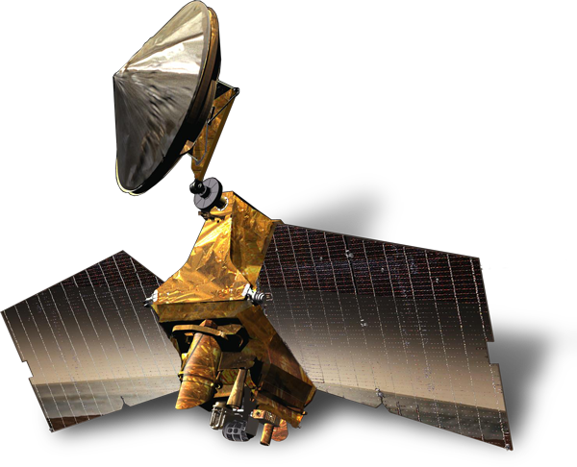

Background
NASA HiRISE - High Resolution Imaging Experiment
Part of the Mars Reconnaissance Orbiter (MRO), launched in August 12, 2005 and reaching Mars in 2006.
Launched with a total of six different imaging tools, along with three engineering instruments and two science facility experiments.
“Primary Science Phase” intended on lasting 2 years, remains in operation today.
Projected lifespan should go into the late 2020s.

Slide 3
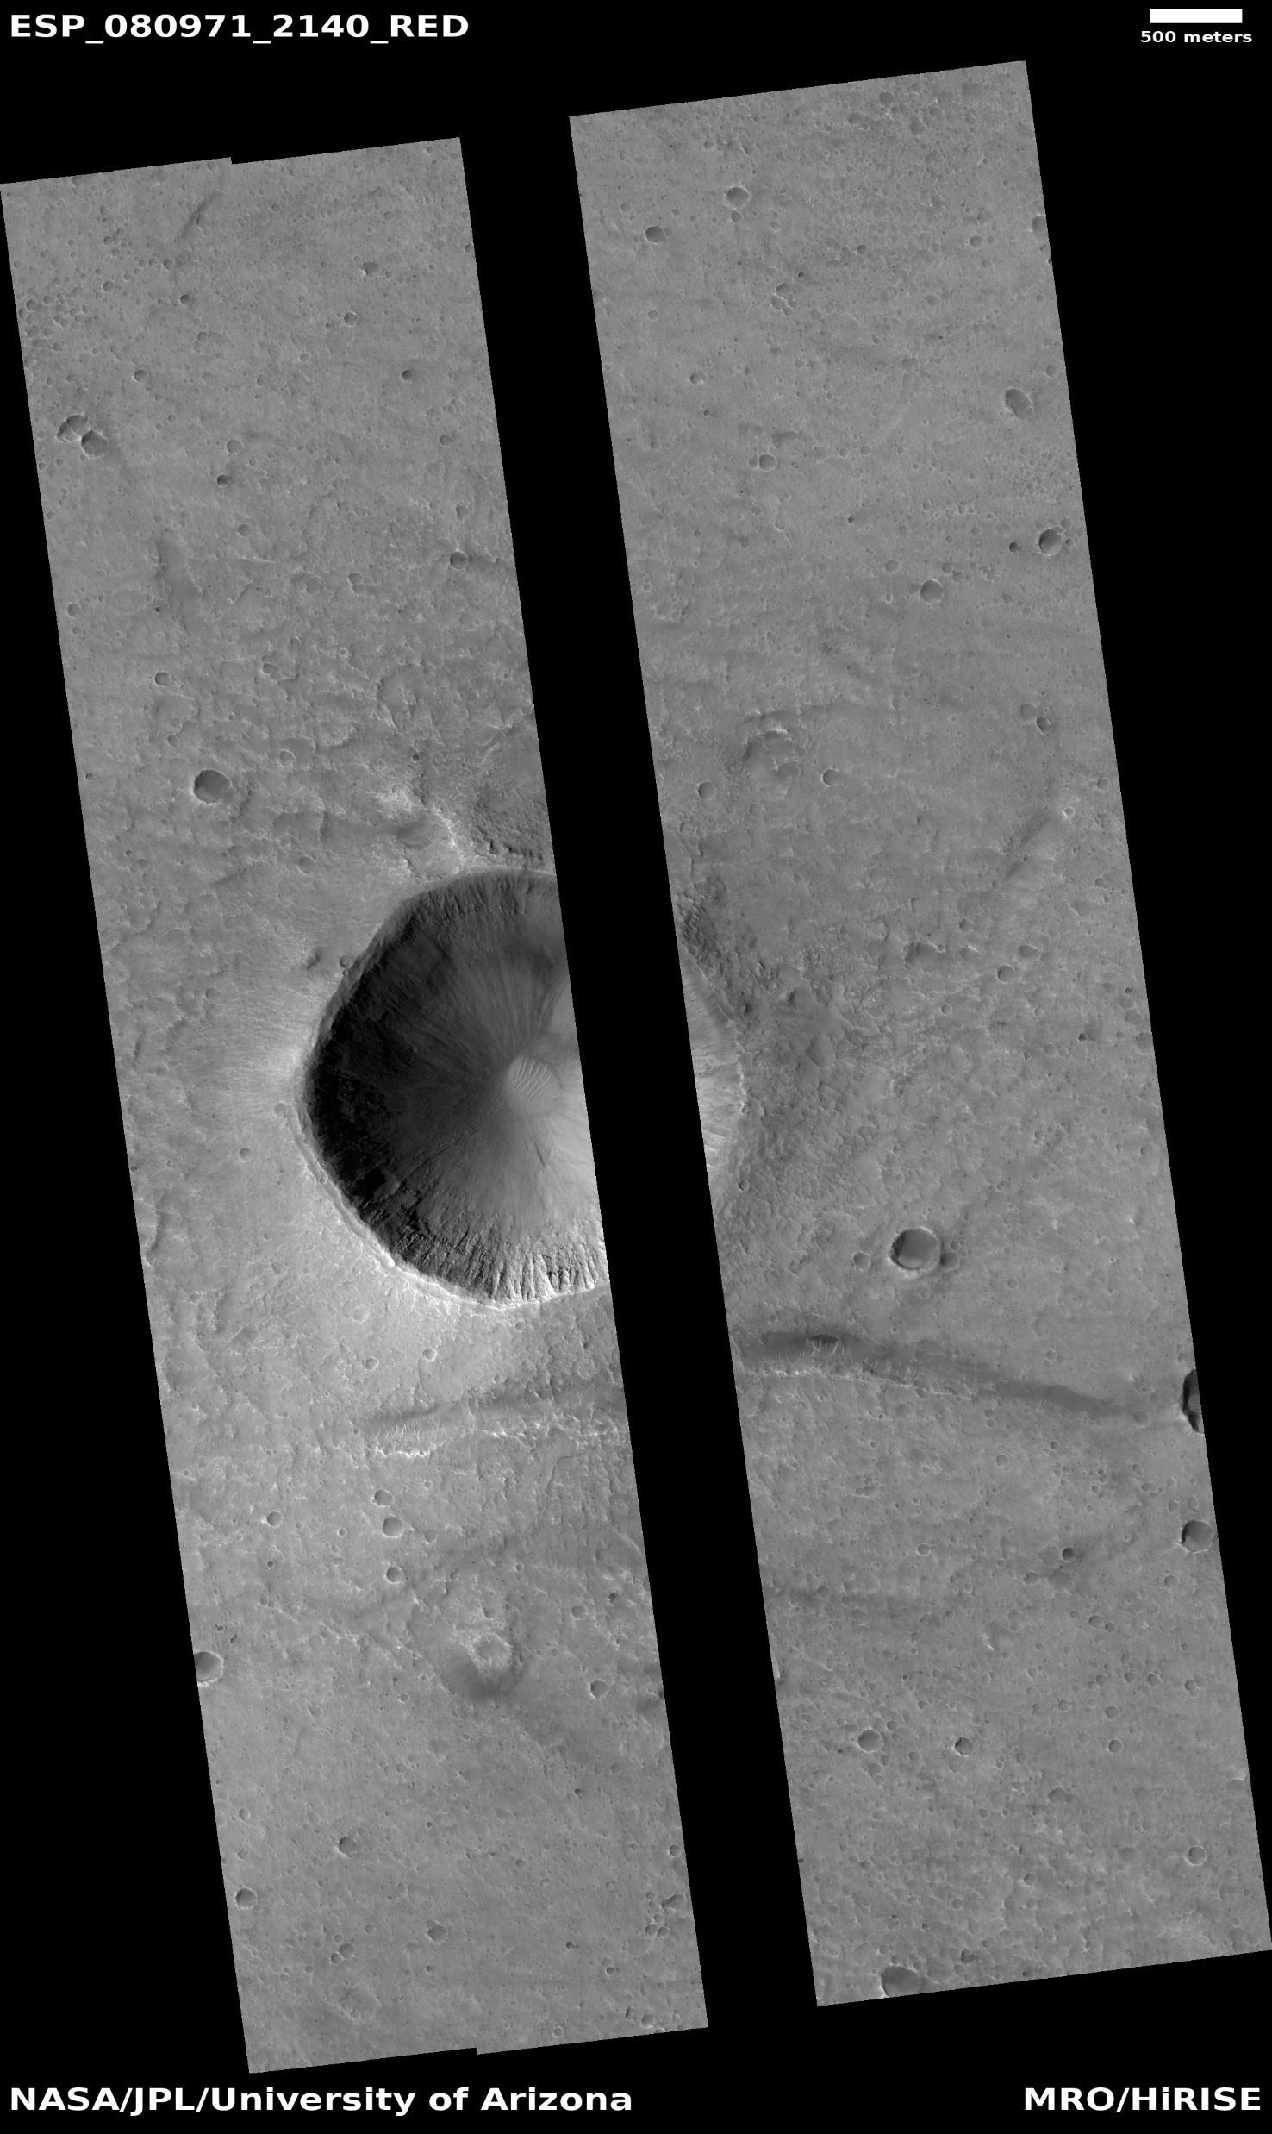
Background
Original captured images are 28 Gb (gigabits)
Approximately 3.5GB (gigabytes)
Constrained by onboard memory capacity limits
Camera Resolution of 0.3m at 300km
Maximum Resolution of 20,000 x 126,000 red pixels
4,000 x 126,000 in B-G and NIR wavelength bands.
Able to use stereo pairs of images to map topography of Mars surface
Images are released to the public as JPEG 2000

Slide 4
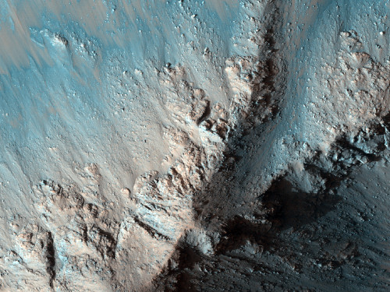
Background
HiRISE images available online for viewing
Stitched together and colored visuals available—shown to right.
Each image contains numerous Mars landmarks of interest
Knowledge of the landscape’s geography is important for future missions
Goal: Identify these Mars landmarks

Slide 5
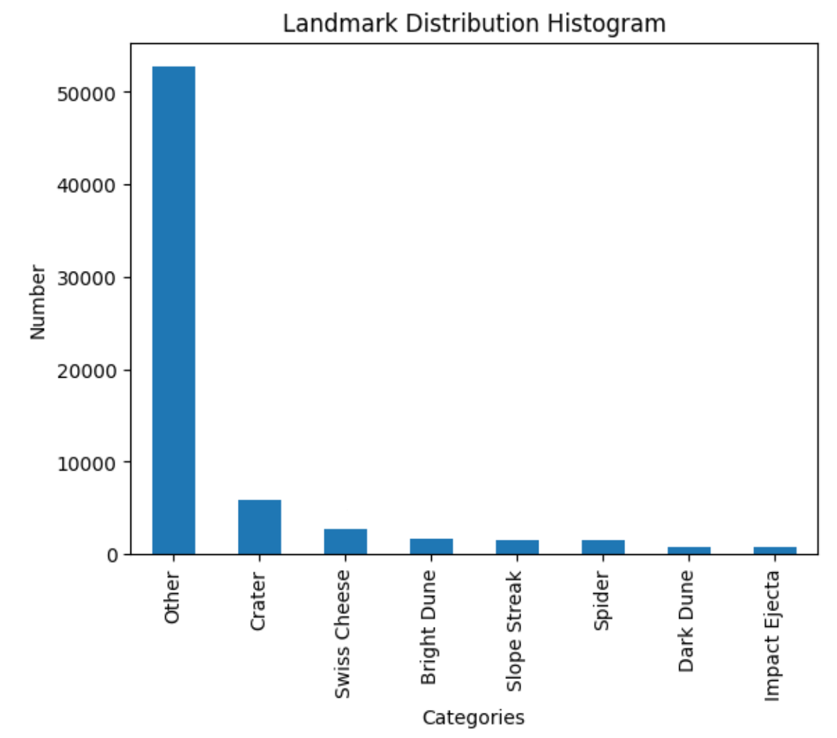
Dataset
Version 3.2 of the Mars orbital image labeled data set
Ongoing project to identify and detect these Mars landmarks.
232 separate source images
10,815 original greyscale landmarks identified and cropped
Mostly from RED Filter CCD (charge couple-device)
9,022 images were augmented with 6 transformations
Final dataset size: 64,947 images
8 different classes.

Slide 6
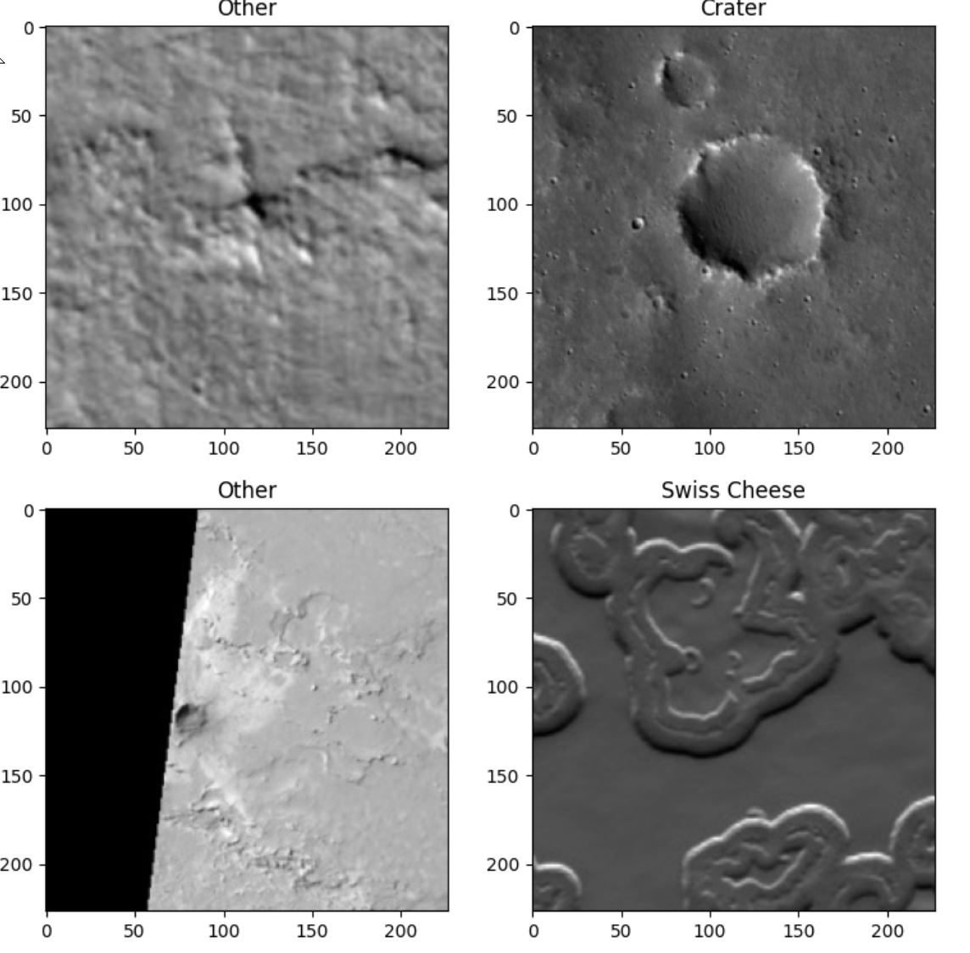
Dataset – Classes
Bright Dune
Dark Dune
Slope Streak
Crater
Impact Ejecta
Swiss Cheese
Spider
Other

Slide 7
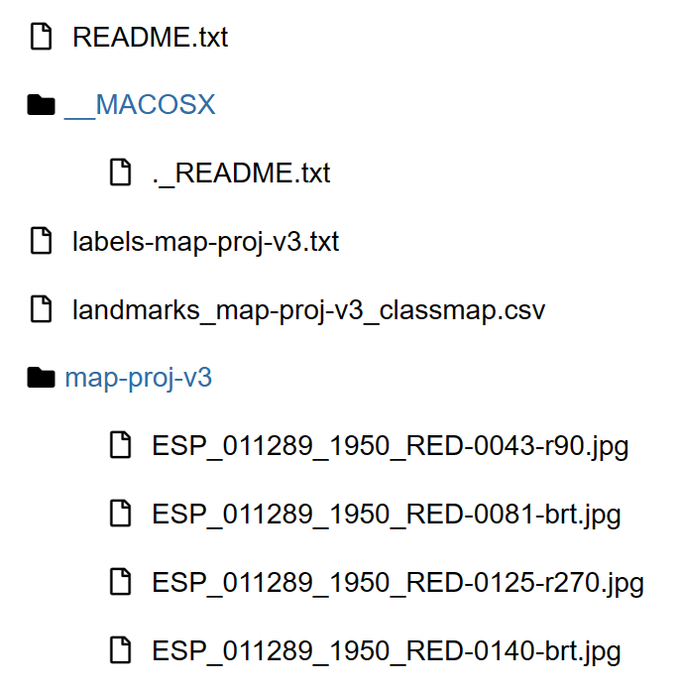
Methodology - Transformations
Utilizing PySpark for data ingestion and processing
Dropping duplicate images
Ingesting images as bytearrays
Resize to 224x224 images
Normalize pixel values between 0 and 1
Saved images as numpy arrays for use with PyTorch datasets to reduce RAM usage during training.
Split dataset into 75% training, 25% test.

Slide 8
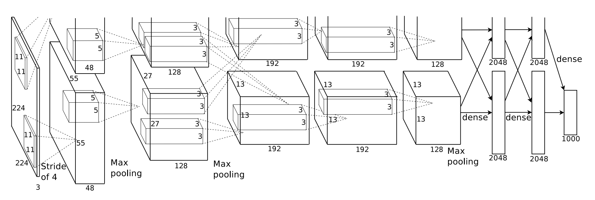
Methodology - Model
Utilizing the AlexNet model, made with PyTorch.
5 convolutional Layers with max pooling
3 Fully connected Relu activation layers
Chosen for a mix of training speed, performance, and robustness to image variation, which comprises most of the dataset.

Slide 9
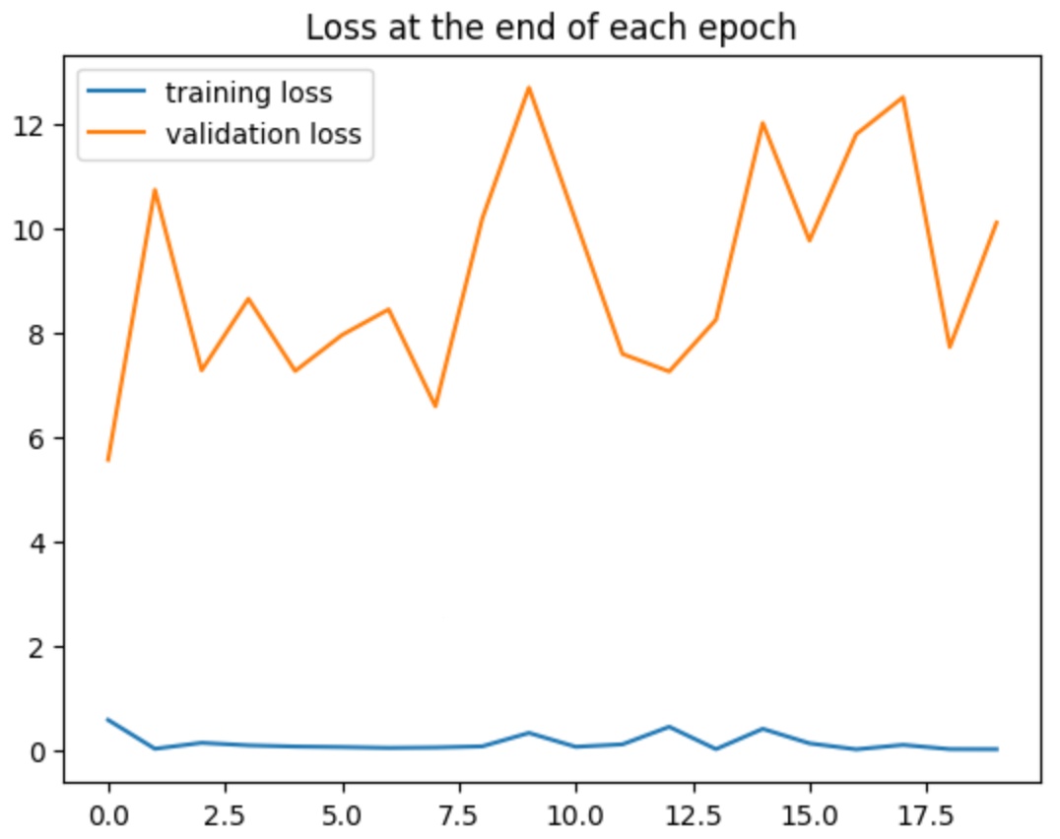
Methodology - Training
Training was done for a total of 20 epochs via GPU locally
Learning rate: 0.005
Batch size of 64
Cross Entropy Loss
Adam optimizer with learning rate of 0.0001

Slide 10
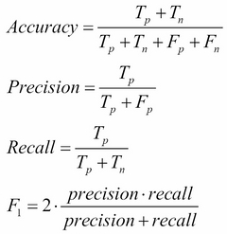
Evaluation
Model results will be based on the following weighted metrics:
Accuracy
Precision
Recall
F1-Score

Slide 11
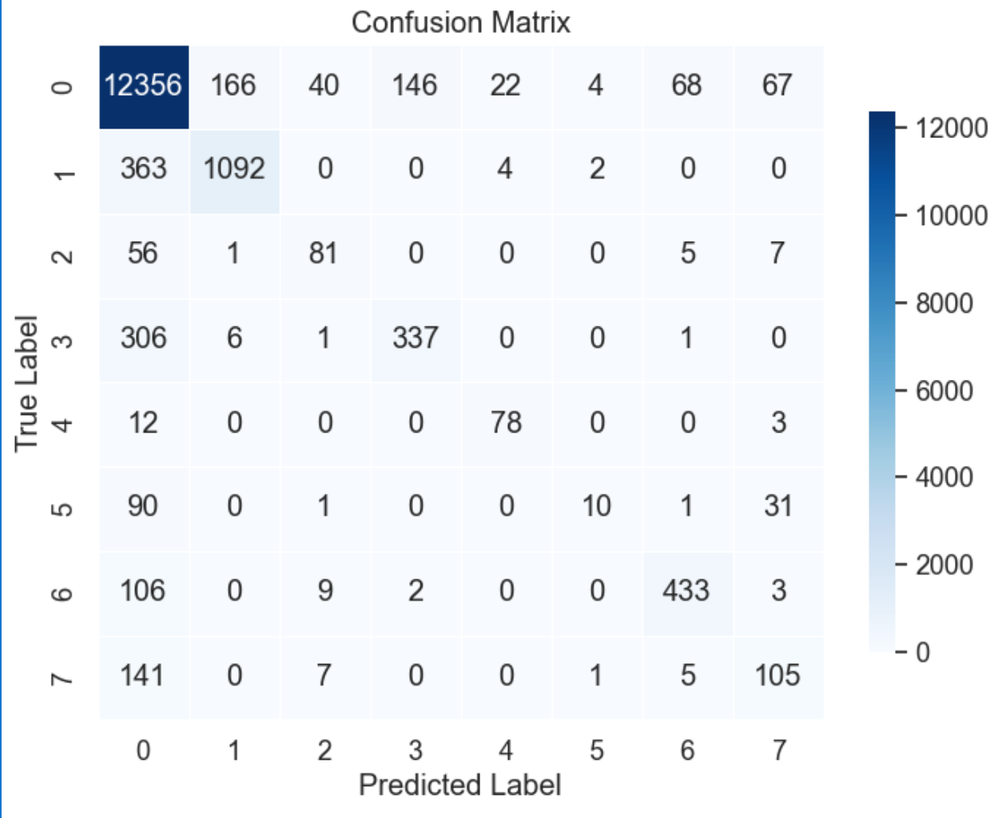
Results
Metric | Value
Accuracy | 0.8963
Precision | 0.8894
Recall | 0.8963
F1 | 0.8963

Slide 12
Conclusions and Future Work
Performance of the model appears to be quite accurate at identifying given landmarks, but…
Overrepresentation of the “Other” category is an issue
More needed work to find suitable solutions for sampling or fixing data
Lack of diversity in overall data regarding specific landmarks
Future Considerations:
Adjusting model hyperparameters
Different model architectures
More unique data sources

Slide 13
Thank you! Any Questions?

